Slide 1
Name-Swapnil Khot
Roll Number- 1803047
Department-CSE
ISE Research Methodology

Slide 2
Title- State of the art in hard turning
Authors :
a) Onam Bharti : M Tech (CE).
b) Mrs. Monika Malhotra : Assistant Professor World Collage of Technology and Management , Farukh Nagar Gurgaon Haryna 122506
Journal :
International Journal of Computer Science and Information Technology
Volume 5, Issue 6, June 2016, Pages 1-9.
Impact Factor: 5.258.
Received Date- 6 June 2011
Accepted Date- 25 August 2011

Slide 3
Number of pages- 9
Number of references cited – 15
Details of sub headings-
1. Introduction
1.1 Natural Language Processing(NLP).
2. Literature Review
2.1 Tasks in NLP
2.2Automatic Summarization
2.3 Coreference resolution
2.4 Discourse analysis
2.5 Machine Translation
2.6 Morphological Segmentation
3. Conclusion
4. References

Slide 4
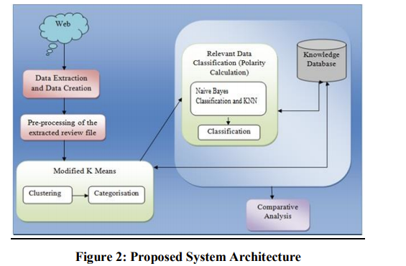
List of Figures
1. System Architectures.

Slide 5
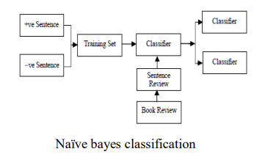
List of Figures
1. Classification.

Slide 6
Research gap / future directions for research reported
Only for tweets with English language can be analyzed and sentiments can be calculated.
No work for other languages.
Data set for stop words is also not available for other languages.
Also we have different data-set patterns for different approach.
Hence dataset has to be in particular format.

Slide 7
My Observation and Comments
Authors have referred 15 classical papers in the field of Sentiment Analysis and had explained about different approaches for project.
Most of references includes Data Mining and NLP concepts and how the can be used in project, and yes author has precisely summarized both of this points .
Arrangement of data with proper figure at required places is done.
Explanation of Algorithm which is most important part is done well.
I chosen this research paper as it provides me with required material for dataset, NLP concepts along with proper approach for my project

Slide 8
My Plan of Research Topic
Probable Title –Sentiment Analysis.
Probable objectives –
To study the tweets of particular person and understanding the emotions that the person wants to express with his tweets.
With this we are able to understand the persons mindset for particular incident on which he has posted his tweets.

